Slide 1
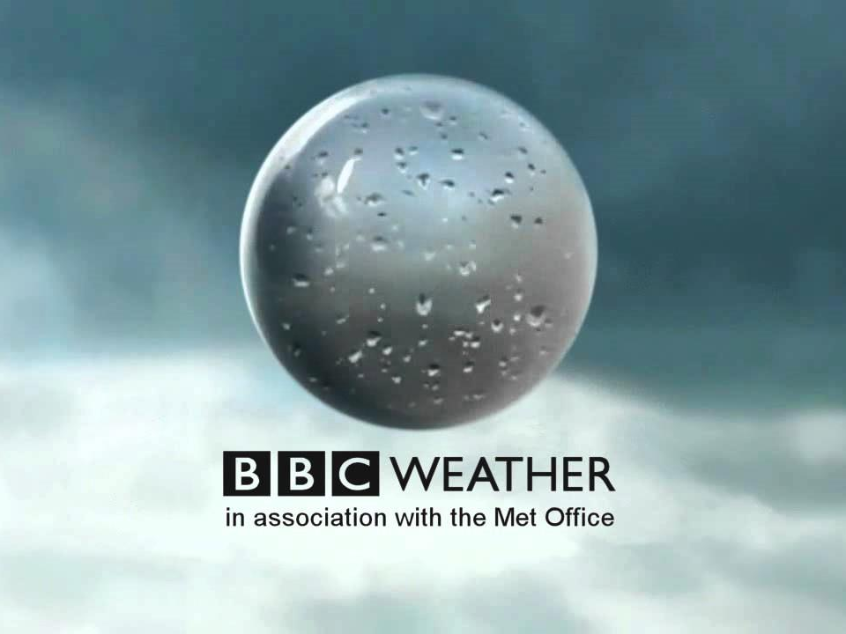
…your name…

Slide 2
Today’s Weather
London this morning:
Temp: … °C
Rain: … mm
Wind: … mph East
…°C
…°C
…°C
…°C
…°C
…°C

Slide 3
Today’s Weather
London this afternoon:
Temp: … °C
Rain: … mm
Wind: … mph East
…°C
…°C
…°C
…°C
…°C
…°C

Slide 4
Weather of the Week
SAT
SUN
MON
TUE
WED
THU
FRI
*
*
*
weather
in words
weather
in words
weather
in words
weather
in words
weather
in words
weather
in words
weather
in words
…°C
…°C
…°C
…°C
…°C
…°C
…°C

Slide 5
Last but not least…
A swarm of bees in may
is worth a load of hay.

Slide 6
…your name…

Slide 7
Weather Icons
*
*
*
*
*
*
*
*
*

